Slide 1
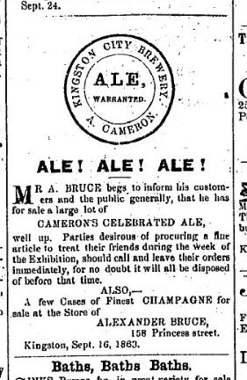
Brewing and Drinking Kingston 1790-1867
Alan McLeod
October 22, 2026

Slide 2
Any Questions?

Slide 3
What Is Beer?
Water – not all water sources make good beer
Malt – grain briefly sprouted then dried converts starches to sugar
Yeast – converts sugar to alcohol and CO2
Hops – green blossoms of a woodland vine
Very Basic Equipment – iron pot and casks

Slide 4
Why Study Brewing?
links historic events to day-to-day life
traces path of economic development
illustrates differences between social classes
invites comparison with today’s social standards

Slide 5
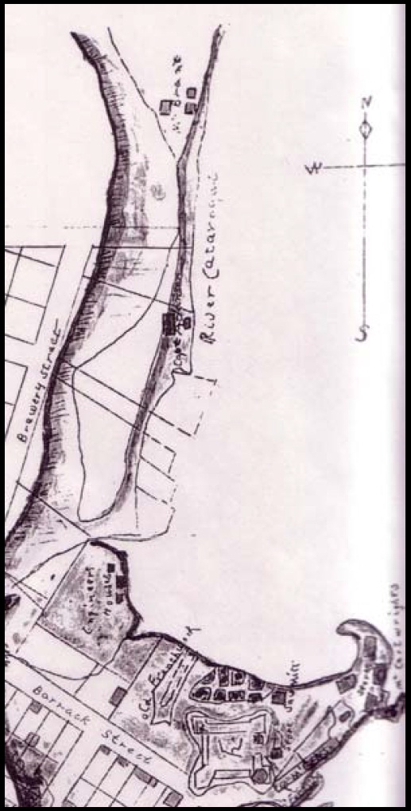
Finding The Information
“On May 27, 1794, a petition had been presented in Council on his behalf for “a Piece of Land about the usual Size of a Town Lot, situated on the West side of a Lot lately laid out for the Kingston Brewery, to be bounded on the North by the said Brewery on the East by a small run of Water, on the South by the Common, & on the West by the top Bank…”
1790 map with 1794 text From The Parish Register of Kingston Upper Canada 1785-1811.

Slide 6
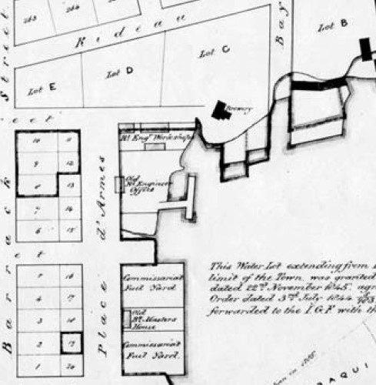
Same Area 1849
A
Structures of the successor to the original Kingston Brewery still sits at Bay and Wellington. In 1849 (shown at A) it’s set among military buildings and not in line with street grid.

Slide 7
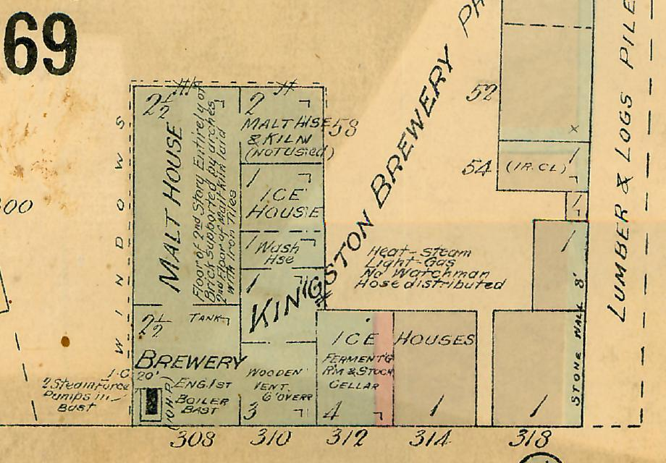
Kingston Brewery in 1908
Detail of a 1908 Fire Insurance Map, corner of Bay and Wellington

Slide 8
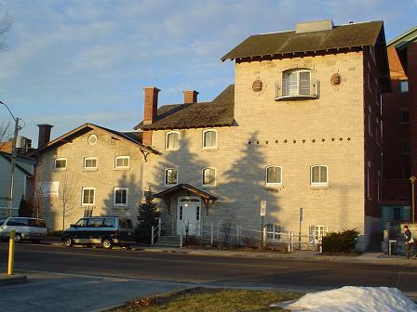
Bay and Wellington Today

Slide 9
Key events in British Kingston pre-1860
1783/1784: Crown survey, Loyalist settlers soon arrive
1785: navy and government moves from Carlton Island
1790s /1820s: military and merchant wheat economy
1815/1846: UK corn laws stifle wheat trade with Britain
1832: opening of Rideau Canal
1832/1840: Fort Henry built
1840: fire destroys much of core of Kingston
1841/1844: Capital of United Canada
1846: Kingston Town Act brings municipal government
1850s: railway connects London Ontario

Slide 10
Four of Kingston’s Classes
Soldiers: 1795 diary observations
Brewers: 1793 mapping / newpaper ads
Farmers: Bath’s Andrew Miller
Leaders / Mercentilists: Richard Cartwright Jr

Slide 11
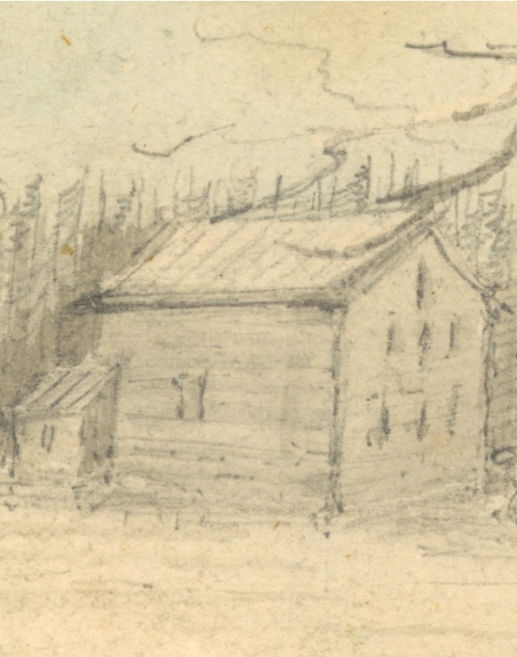
Richard Cartwright Jr.
Richard Cartwright Jr. was the leading commercial and political Loyalist to settle in Kingston. During the American Revolution, he gained experience in military provisioning and commercial contacts.
By 1793 his firm held exclusive garrison supply contracts in lower Great Lakes. He built his commercial empire of the St Lawrence from England to Montreal and through Kingston to Niagara until his death in 1815 at just 55. In 1801 more than 25 per cent of all the flour shipped to Montreal from Upper Canada was his property.
Sketch of Cartwrights’ mill, Napanee, by Lady Simcoe

Slide 12
Early Loyalist Brewing 1780s
Joel Stone, founder of Ganonoque arrives in western townships Quebec in 1787:
  “Stone once had high hopes in this new land, even petitioning Sir Guy Carleton to make him “Deputy Surveyor General.” Stone would receive no such government office upon arriving in Canada. Instead he wrote to his father, “I have begun making malt brewing beer and distilling spirituous liquors from wheat, barley, rye etc…”

Slide 13
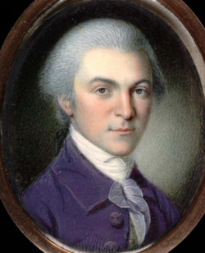
Kingston in 1790s
The Duke de La Rochefoucault Liancourt travels through in the mid-1790s:
“Kingston, considered as a town, is much inferior to Newark ; the number of houses is nearly equal in both. Kingston may contain a few more buildings, but they are neither so large nor so good as at Newark. Many of them are log-houses, and those which consist of joiner's work, are badly constructed and painted. But few new houses are built. No town-hall, no court-house, and no prison have hitherto been constructed…”

Slide 14
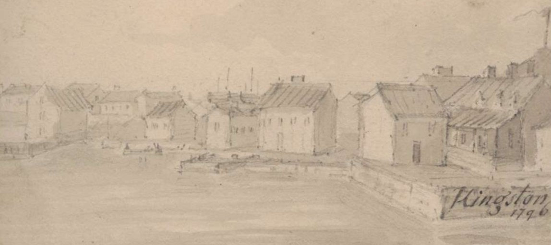
Drinking with Officers
  “The ingenuity of the English in devising toasts, which are to be honoured with bumpers, is well known. To decline joining in such a toast would be deemed uncivil… Unwilling to oppose the general will, which becomes more imperious in proportion as heads grow warmer, you resort to slight deceptions in the quantity you drink, in hopes thus to avert the impending catastrophe...”
Detail of sketch at Kingston, Lady Simcoe

Slide 15
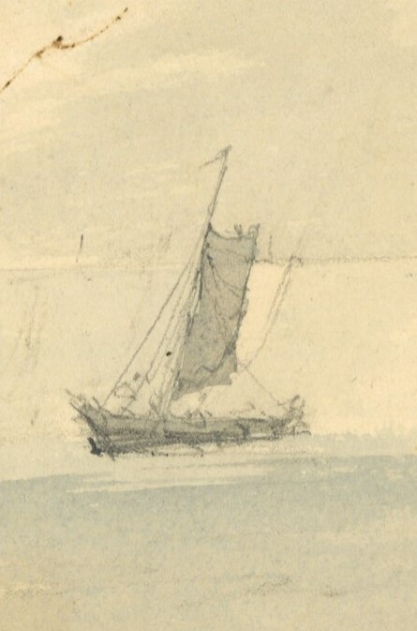
And A Day with Soldiers
  “To beguile ennui, and enjoy a few hours longer the society of our friend, Captain Parr, we accompanied him to the distance of six miles from Kingston. His detachment occupied seven vessels, and he had one for himself. The soldiers were without exception as much intoxicated as I ever saw any in the French service. On the day of their departure they were scarcely able to row, which rendered our tour extremely tedious...”
Detail of sketch at Kingston, Lady Simcoe

Slide 16
Types Of Local Beer
Spruce Beer: British military, no longer made
Wheat Malt Ale: Dutch NY, no longer made
Bigg Ale: six-row inferior barley strain
Barley Malt Ale: English two row used today
Barley Malt Lager: Germans introduce in 1840s

Slide 17
What Is Spruce Beer?
“Take 7 Pounds of good spruce and boil it well till the bark peels off, then take the spruce out and put three Gallons of Molasses to the Liquor and and boil it again, scum it well as it boils, then take it out the kettle and put it into a cooler…”
Order of Gen. Jeffery Amherst, 1759

Slide 18
Who Brings in the Molasses?
Richard Cartwright Jr!

Slide 19
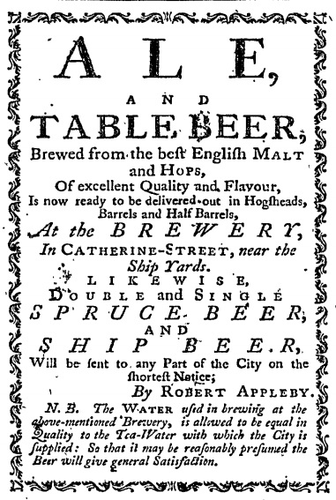
Spruce Ale at NY Shipyards in 1781
Loyalist Robert Appleby on 1 November 1781 in New York paper indicates he is brewing with the best English malt and hops but also making both double and single spruce beer. He also states that the water is as good as the “Tea-Water” which is likely not truce. He is supplying the British Ship Yards and has ship beer in supply. Appleby leaves for Nova Scotia with British forces in 1783.

Slide 20
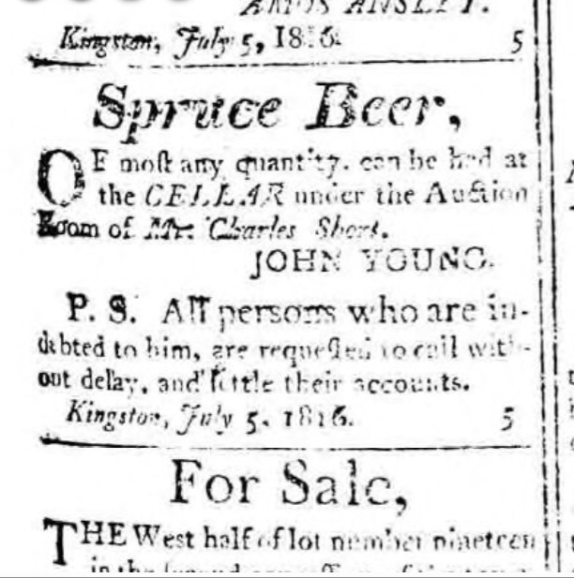
Spruce Ale in 1816
Grim stuff made in a cellar for the lower end of society.
John Young leases his space and he is owed money

Slide 21
What is Wheat Ale?
Diary of Peter Kalm, Swedish economist visits New York, 1750s :
  “Rye is likewise sown here, but not so generally as wheat. They do not sow much barley here, because they do not reckon the profits very great. Wheat is so plentiful that they make malt of it. In the neighborhood of New York, I saw great fields sown with barley. They do not sow more oats than are necessary for their horses.”

Slide 22
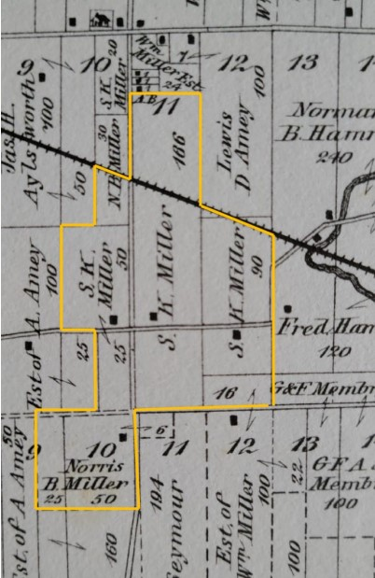
Wheat Farming Begins
Andrew Miller (c. 1757-1828) born in New York fought as part of Jessup’s Ranger during the American Revolutionary War.
On discharge he was granted lands north of Bath at the end of the war.
Family holds original deed from 1803 but evidence shows Miller he was farming as early as 1784.

Slide 23
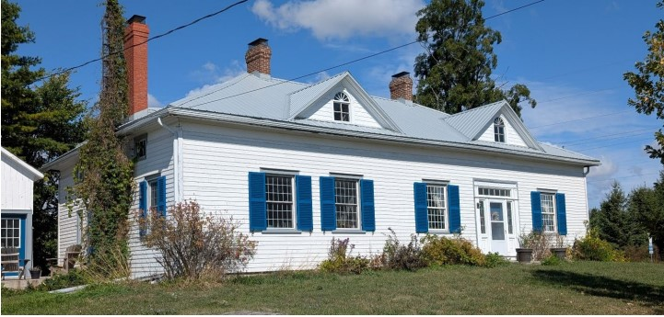
Wheat Farming Prosperity
Understood to have been built circa 1810-1811, this home north of Bath is still a residence of a direct descendent of Andrew Miller, Ivan MacKinnon of MacKinnon Brother Brewing. A corner of the cellar includes foundation for the family’s first log cabin. The family still grows grain, primarily wheat for the seed grain trade.
Image from Loyalist Twp Report SR-3067, Oct 2025.

Slide 24
Who Controls the Wheat Trade?
Richard Cartwright Jr.
aka
“The Only One”

Slide 25
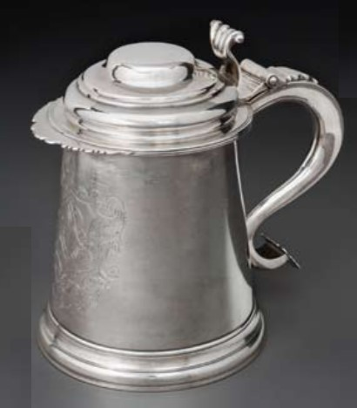
Beer and a Brewer to Toronto, 1801
Rev. John Stuart reported to the Bishop of Nova Scotia, Kingston, September 14, 1801:
  “A Brewer from Kingston removed to York lately and, on application to the Governor, obtained one of the King’s vessels to transport wheat and other Grain from Kingston and the Bay of Quintie, before beer could be made – and almost all the Pork, Beer, Butter, Flour, Hams, Mutton, which are used at York are brought by water, from Kingston, Niagara, the Genesee Country…”
Image: In 2010, The Museum of Civilization acquired the historic silver tankard of Rev John Stuart. The tankard was made in 1742.

Slide 26
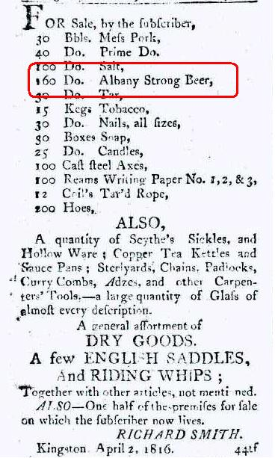
Beer Imports in 1816
This notice is from the Kingston Gazette on April 27th 1816. Highlighted text shows 160 barrels of Albany Strong Beer are on offer at Richard Smith’s Store. I understand Smith’s Store was next to Milestone Building on Princess Street, now a parking lot across from Pan Chancho.
In 1816 Kingston has about 4,000 people. 160 barrels is 5,120 gallons or over 40,000 pints. No Rideau Canal or Erie Canal. There are rapids on the St. Lawrence all the way to Montreal. The War of 1812 ended one shipping season before… unless it was brought by sleighs. Brought by river barge otherwise.
.

Slide 27
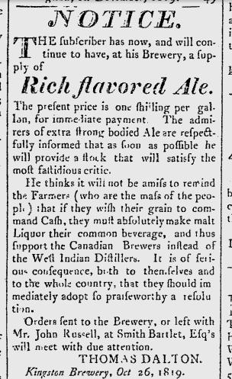
Import Competition in 1819
This notice was placed on 26 October 1819 a Kingston newspaper by brewer Thomas Dalton. He seeks ale drinkers customers and malt suppliers of local grain for his extra strong bodied ale.
Dalton nationalist arguments to encourage Canadian beer over West Indian rum: “…of serious consequence to themselves and the whole country
…”

Slide 28
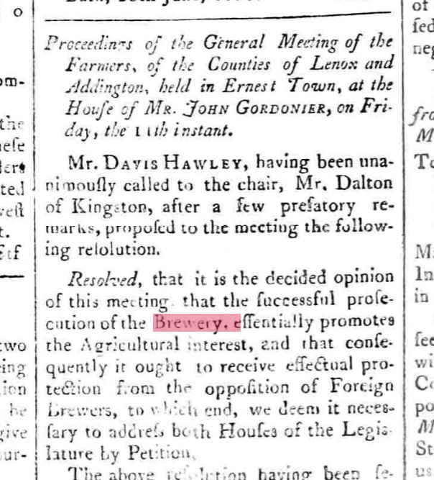
Dalton Meeting of 1820
A year later, Thomas Dalton holds a meeting of Farmers in Ernest Town on 11 August 1820. Held at home of John Gordonier, son of Loyalist who moved from Albany NY at the end of the Revolutionary War.
Dalton seeks agreement on a petition to the Legislative Assembly to support brewers and farmers from “Foreign Beer”.

Slide 29
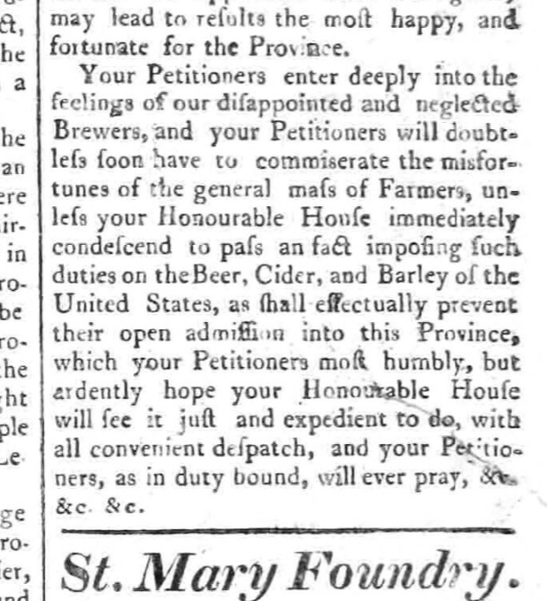
Dalton Meeting of 1820
Dalton’s petition asks for imposition of duties on “…Beer, Cider, and Barley of the United States as shall effectually prevent their open admission into this Province…”
Kingston Chronicle on
1 September 1820

Slide 30
Sir Robert Barrie
Barrie lived in Kingston from 1819 to 1825, commanding the navy yards. While here he took interest in self-sufficiency, building a greenhouse and even taking up brewing:
…brewed my own ale from the hops of this country—as good ale as ever I drank in England. The Kingston brewers are in arms against me, as I expose their cheats. My very strong ale does not stand me six pence the gallon.”
From Whig Standard article, Sarah Gibson, 25 May 2012

Slide 31
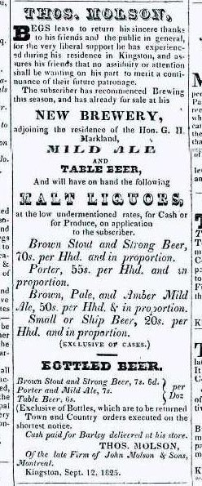
Kingston in 1825
Thomas Molson was a partner the Montreal brewery until 1822 when he moved to Kingston. Owned extensive brewing and distilling operations from 1824 to 1835 near what is now the Kingston Yacht Club.
Far more sophisticated than other breweries. He brewed eight sorts of beer in five price ranges with wholesale and retail sales. Casks and bottles. Notice also that sales are “for Cash or for Produce.” bought barley to make their own malt.

Slide 32
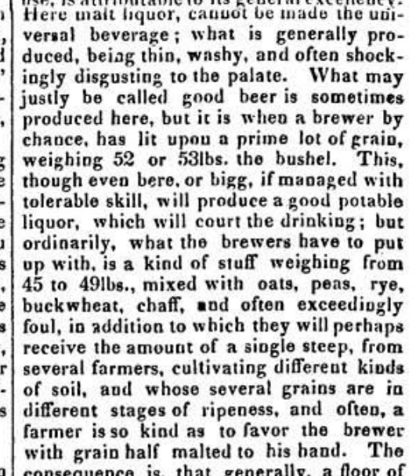
Beer Still Poor in 1832
This is a passage from a long column in the Kingston Chronicle of 26 May 1832, the month that the Rideau Canal opened.
The writer states that local beer is “thin”, “shockingly disgusting” and “exceedingly foul” made of bigg mixed with “oats, peas, rye, buckwheat and chaff.”
Like Dalton 12 years before, his opinion piece is a call to farmers to improve the barley supply.

Slide 33
Election Day 1836
”There was only one polling place and that was in Bath. It was a little booth at the edge of the village. I was quite a young man at the time and didn't know much about the issues; but I could understand that the people were greatly excited. The taverns of Bath were crowded with men wrangling about the votes. Whiskey was flowing freely, and there were plenty of drunken men and brawls in the streets. There were plenty of taverns all over the county.”
From History of the County of Lennox and Addington (1913) by W.S. Herrington

Slide 34
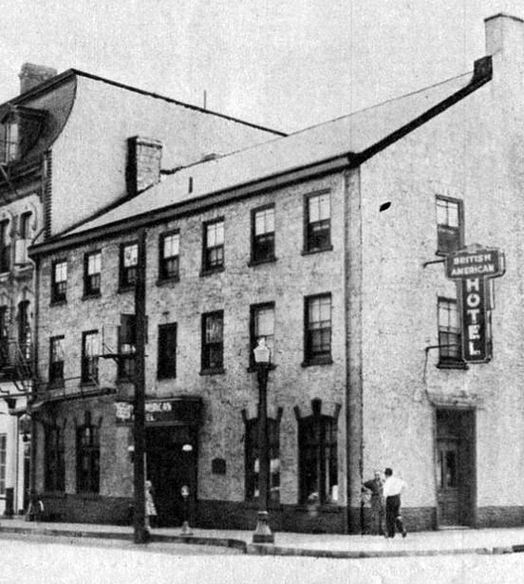
Harry Jones’ 1840s Diary
A lower level clerk in the colonial bureaucracy located in Kingston in the early 1840s, Jones spent his gentlemanly social hours life with single men like him exploring the better sort out of the 98 local town and country taverns. Drank wine, sherry cobblers, brandy and even grog but not much beer. At this point in the century, society life was still centered around the tavern and was separated by class more than temperance.
The British American Hotel, now the location of the Marriott. Dickens stayed here in May 1842 and wrote “Kingston… one half of it appears to be burnt down…”
In Mixed Company, Julia Roberts

Slide 35
Barriefield 1850
“To the Honourable the Municipal Council of the Township of Pittsburgh in Session aforementioned, We the Undersigned Tavern Keepers of the Village of Barriefield humbly and respectfully sheweth - whereas that there are persons residing in the said Village or premises adjoining Selling Beer and Keeping Houses of Rendezvous against the Law and to the great Desparagement of Her Majesty…”
Petition, 18 April 1850, from "Tavern Inspectors Records 1849-1853“, PittsburghTownship records.

Slide 36
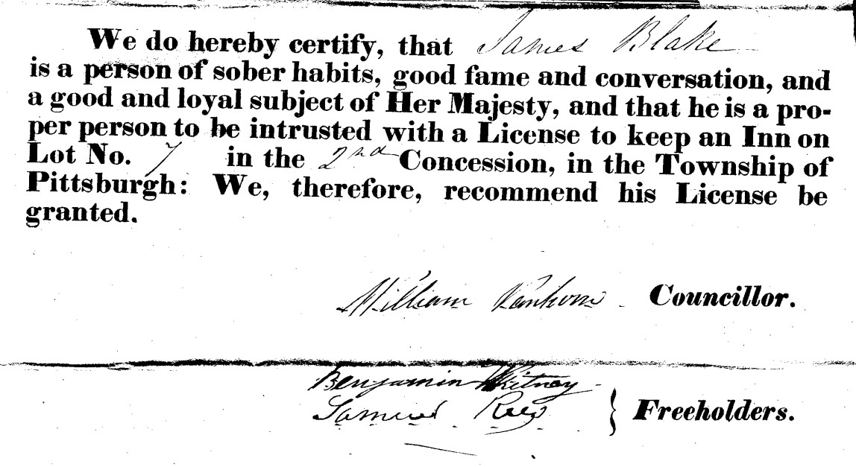
Pittsburg Township Permit 1853

Slide 37
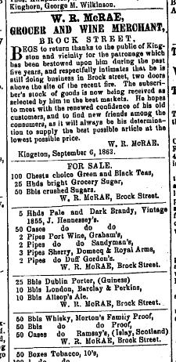
UK Imports in 1862
In Kingston Daily News of 7 October 1862, Mr. McRae of Brock Street advertises had 25 barrels of Guinness, as well of ten barrels each of Barclay Perkins and Allsopp ales along with a range of fine imported sherries, ports and brandies. Only the Morton’s “Family Proof” Whisky he offered was locally made.
The bottom two stories of McRae’s building are still there at the corner of Brock and Wellington, housing Pearle Optical across the street from the Wellington Currency Exchange.

Slide 38
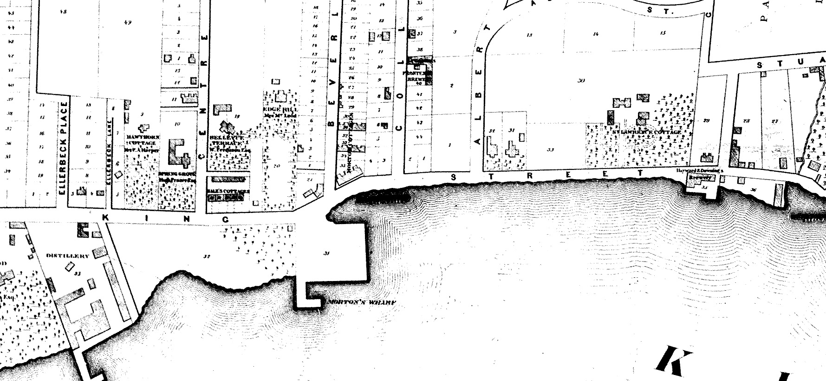
Breakwater Park in 1865
B
A
C
A. Morton Brewery and Distillery, now Bader and Tett Centre
B. Frontenac Brewery, now under the GordBrock House at Queens
C. Hayward & Downing, now a suspicious mound at Breakwater Park’s east end

Slide 39
Any More Questions?

Slide 40
Further Reading
The Art And Mystery Of Brewing in Ontario, Ian Bowering (1988)
Brewed In Canada, Allen Winn Sneath (2001)
In Mixed company, Julia Roberts (2009)
The Breweries of Kingston and the St.Lawrence Valley, Steve Gates (2011)
Upper Hudson Valley Beer, Alan McLeod and Craig Gravina (2014)
Ontario Beer, Alan McLeod and Jordan St.John (2014)
news.ourontario.ca: website managed by the library system

